Slide 1

Data Analysis Essentials
Food Delivery Data Analysis
Frontend Dashboard & Data Analytics
Presented by
B.Bhanu Prakash reddy (25B11AI102)
M.Ganesh reddy (25B11AI772)
G.Rohit reddy (25B11AI388)
T.Santosh reddy (25B11AIC08)
Department of Artificial Intelligence & Machine Learning
GUIDED BY:
A.SOPHIA MAM

Slide 2




Contents
• Abstract
• Introduction
• Existing System & Limitations
• Proposed System
• Dataset Description
• Requirements
• Methodology
• Frontend Dashboard
• Expected Outputs
• Project Workflow
• Conclusion

Slide 3
ABSTRACT
The project focuses on key areas such as restaurant-wise sales, order trends, delivery efficiency, customer ratings, and customer satisfaction.
Using data analysis techniques, the system identifies high-performing restaurants, o peak ordering hours, and factors affecting customer satisfaction. The expected outcome includes clear visual reports and summaries that support better decision-making by restaurants, delivery partners, and platform managers.

Slide 4
Introduction
• Food delivery platforms generate large amounts of data from orders, restaurants, customers, and deliveries.
• The data provides insights into sales, delivery time, and customer ratings.
• Python is used to clean, process, and analyze the data.
• Pandas, NumPy, Matplotlib, and Seaborn are used for analysis and visualization.
• The project helps identify useful trends and patterns in food delivery data.

Slide 5
Existing System
• Food delivery data is generally stored as raw datasets or databases.
• Analyzing large food delivery datasets may require manual effort.
• Finding restaurant-wise sales and order information can be difficult.
• Missing and duplicate records may affect data quality.
• Raw tables are difficult to interpret without visualization.
• Limited analysis makes it difficult to identify important food delivery trends.

Slide 6
Limitations of Existing System
• Manual analysis of food delivery data is time-consuming.
• Large datasets are difficult to manage and analyze manually.
• Missing and duplicate records can affect analysis results.
• Order, sales, and delivery information may be difficult to visualize.
• Identifying customer and restaurant trends can be challenging.
• Manual data processing can lead to errors.

Slide 7
Proposed System
Dataset loading and data exploration
Data cleaning and missing-value handling
Duplicate removal and data preprocessing
Order and sales analysis
Restaurant-wise order analysis
Delivery time and customer rating analysis
Data visualization using charts
Frontend dashboard for summary metrics and insights

Slide 8
DATASET DESCRIPTION
Order ID
Restaurant Name
Order Value
Delivery Time
Customer Rating
Order Date / Time
Location
Order ID | Restaurant | Order Value (₹) | Delivery Time (min) | Rating | Order Date / Time | Location
ORD1001 | Spice Villa | 450 | 32 | 4.5 | 12-03-2025 13:20 | Sector 5
ORD1002 | Pizza Point | 620 | 48 | 3.8 | 12-03-2025 19:05 | Sector 12
ORD1003 | Burger Hub | 280 | 25 | 4.7 | 13-03-2025 12:40 | Sector 5
ORD1004 | Biryani House | 780 | 55 | 3.5 | 13-03-2025 20:15 | Sector 9
ORD1005 | Cafe Aroma | 340 | 29 | 4.4 | 14-03-2025 17:30 | Sector 3
ORD1006 | Spice Villa | 510 | 38 | 4.2 | 14-03-2025 21:10 | Sector 12
https://www.kaggle.com/datasets/abhijitdahatonde/swiggy-restuarant-dataset/data

Slide 9
REQUIREMENTS
Hardware Requirements
• Processor: Intel i3 or above
• RAM: Minimum 4 GB
• Storage: 20 GB
Software Requirements
• Windows
• Python
• Google Collab
• Pandas
• NumPy
• Matplotlib / Seaborn

Slide 10
Analysis methodology
06
Step-by-step workflow we follow
1. Dataset
4. Order Analysis
7. Customer Rating Analysis
2. Data Cleaning
5. Restaurant Sales Analysis
8. Visualization
3. Exploratory Data Analysis
6. Delivery Time Analysis
9. Insights
Each step feeds the next, ending with insights that are easy to explain.
Food Delivery Data Analysis System | Data Analysis Essentials
6 / 12

Slide 11
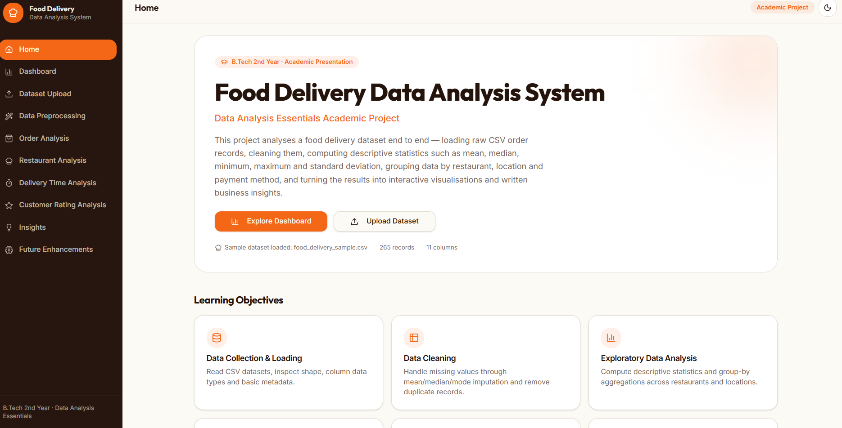
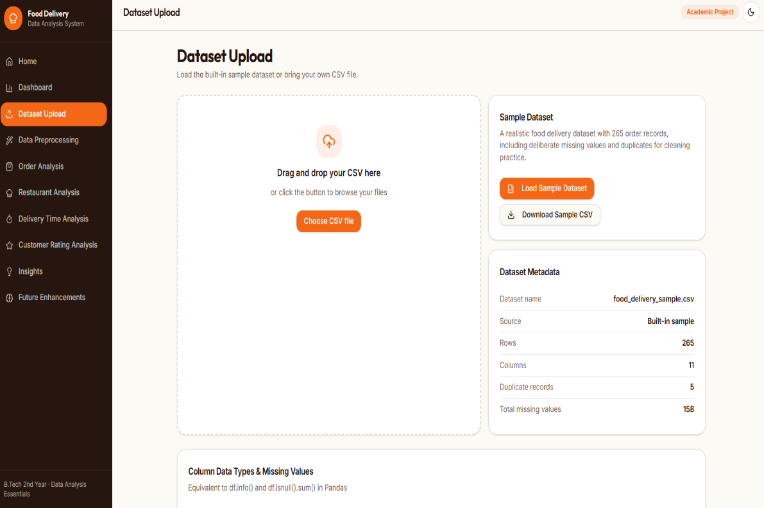
Output Screens
Dashboard:
Upload food delivery Dataset:
https://grubdash-analytics.lovable.app/
Dashboard highlights

Slide 12
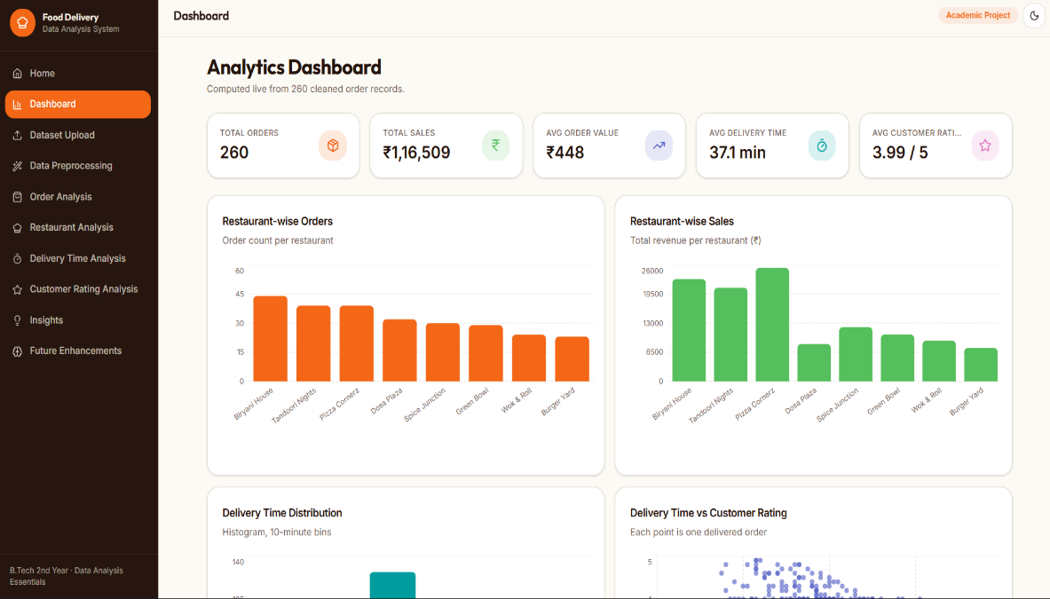
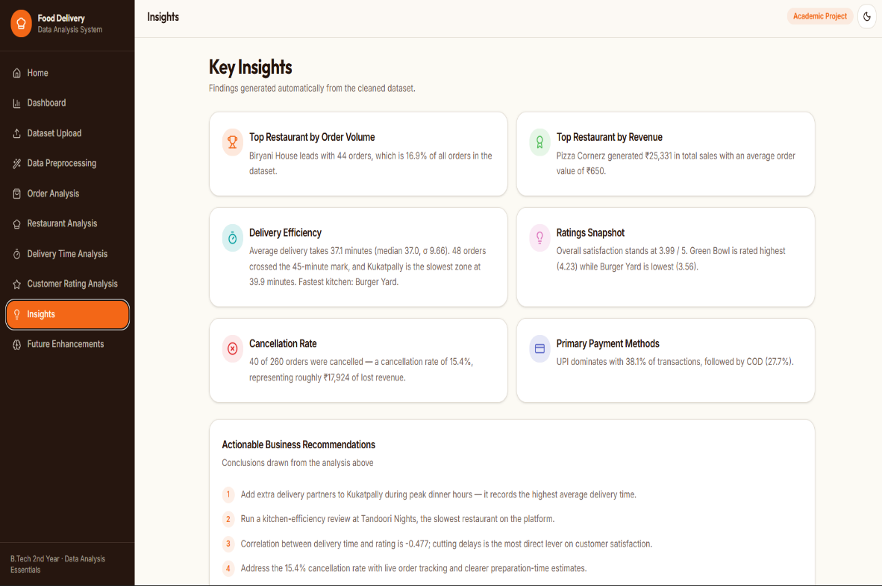
Output Screens
Food Delivery Data Analysis:
Data Insights:

Slide 13
Project Workflow
CSV Dataset
↓
Load Dataset
↓
Data Cleaning
↓
Data Preprocessing
↓
Exploratory Data Analysis
↓
Food Delivery Data Analysis
↓
Visualization
↓
Frontend Dashboard
↓
Key Insights

Slide 14
CONCLUSION
Data analysis explains delivery performance clearly.
Charts make patterns easy to understand.
Restaurants and delivery speed can be compared.
Ratings help study customer satisfaction.
Future scope:
Real-time analytics dashboard
Delivery-time prediction
Restaurant recommendation
Customer segmentation
Real-time delivery monitoring

Slide 15
THANK
YOU

